Slide 1
Non-functional Testing

Slide 2
Objectives
At the end of this session, the participants will be able to:
Understand variety of non-functional testing

Slide 3
Non-functional Testing
Non-functional testing refers to all types of testing which validate attributes of a system other than its ‘functionality’
Usually conducted after or along with functional testing
Examples:
  Performance testing
  Stress testing
  Documentation testing
  Usability testing
  Recovery testing
  Installability testing
  Compatibility testing
  Operational Readiness Testing (ORT)

Slide 4
Performance Testing
Every system has performance objectives. It is necessary to test if the time taken by the system is within these limits under prescribed conditions.
  Example: In case of a customer using an ATM, password validation should take no more than 4 seconds. If it is properly done after 6 seconds, functionality is still correct but performance objectives have not been met.
When large number of users access a system simultaneously, the performance tends to degrade.
It is necessary to simulate large number of users and thus using a tool is necessary (e.g. LoadRunner)
Before conducting performance test, it is necessary that the related functionality is stable
Notes:
Performance Testing : is a test whose objective is to determine the maximum sustainable load the system can handle
-Performance at various condition
-Check System behavior
-Stress Testing
-Volume Testing
-Load Testing

Slide 5
Stress Testing
Exactly as the name suggests, it checks how the system performs under stress
System is run under less-than-ideal conditions such as low memory, low disk space, slow CPU, slow modems, etc
It can uncover errors which could cause failures even under normal operating conditions
Notes:
Stress testing is subjecting a system to an unreasonable load while denying it the resources (e.g., RAM, disc, interrupts, etc.) needed to process that load
Break and Found bugs behavior.
System should fail in decent Manner
Simulate real time situation
Use automated tools

Slide 6
Documentation Testing
End users consider the non-software components as part of the overall software product
Types of documentation supplied with software:
  User manual including installation instructions
  Online help
  Tutorials supplied with software
  CBT (Computer Based Training)
Tester must check that the documentation is ‘in-sync’ with the software product
Good documentation improves software quality by improving its usability and lowering support cost
If ‘Documentation testing plan’ is not included in overall test plan, tester should raise it as an issue

Slide 7
Usability Testing
Usability means how appropriate, functional and effective is the interaction between software and its user.
Seven common traits of a good UI (User Interface)
  Follows standards and guidelines
  Intuitive
  Consistent
  Flexible
  Comfortable
  Correct
  Useful

Slide 8
Recovery Testing
A running system can halt due to reasons such as hardware failure or data errors or power outage. There are specified procedures to initiate a recovery in such an event.
Recovery testing implies bringing a system to a halt, artificially, so that its recovery procedure can be verified
Post recovery the data should become available as per the specification
Notes:
More examples such as halt of a railway reservation system can be given – what happens to those reservation txns which were half way through when the system halted. Check if -- post recovery -- the data looks as per the specification.

Slide 9
Recovery Testing …
Example
  If a bank ATM halts due to power outage with an ATM card inserted, the card should be held back and not returned to the customer
  If a cash withdrawal txn has been entered in the customer’s account but cash not yet given out, such a txn should be reversed
  Recovery testing here means – a ‘customer’ inserts an ATM card and requests for cash withdrawal and then power supply is switched off. It is then verified if the software and ATM behave as specified.

Slide 10
Installability Testing
Many software products have a complex installation procedure.
As a part of non-functional testing, the vendor has to carry out installability testing – i.e. install the product on a variety of applicable platforms and check the correctness of installation.
Usually this is a first step for a user of a software product
Also, faulty installation may prevent the user from accessing certain components of the products – resulting in unhappy customers and high volumes of calls logged to helpdesk
Notes:
.

Slide 11
Compatibility Testing
Verifying that the system interacts with and shares data correctly with other systems. ( ‘Correctly’ means as per specifications)
Before performing compatibility testing of a software find the following:
  What other operating systems (or web browsers) and application software is this software specified to be compatible with?
  What compatibility standards should be followed that defines the interaction of this software with other software?
  What types of data will this software use to interact and share information with other platforms and software?
These can be found out from the software specification and if needed, directly from the vendor
After obtaining this information, you will have to design the test cases to cover all possible scenarios

Slide 12
Operational Readiness Testing (ORT)
Before a system is ready to move into production (i.e. become operational), it is tested for various aspects seen earlier.
However, there is one more important aspect which needs to be tested – Operational Readiness
  Network readiness (bandwidth, routers, modems, etc)
  Hardware readiness (memory, disk space, etc)
  User readiness (user training)
  Commercial readiness (whether the new offering have been adequately publicized)
  Legal readiness (whether new offering is legal in that part of the World)

Slide 13
Security Testing
Security testing Process to determine that an IS (Information System) protects data and maintains functionality as intended.
Process to assess the trustworthiness of the security mechanisms and is often regarded as a special case of system testing.
Security testing is not to establish the functional correctness of the software but to establish some degree of confidence in the security mechanisms.
Organizations test the security of their systems, firewalls and networks either by using commercially available vulnerability tools, penetration testing, or by using formal methods.
Notes:
Other methods for security testing have been developed, including syntax testing, property-based testing, fault injection, mutation testing and Gligor’s testing method. These techniques are limited to finding specific security flaws.

Slide 14
Security Testing
The six basic security concepts that need to be covered by security testing are:
  Confidentiality
  Integrity
  Authentication
  Authorisation
  Availability
  Non-repudiation
Notes:
Confidentiality
A security measure which protects against the disclosure of information to parties other than the intended recipient that is by no means the only way of ensuring confidentiality.
Integrity
A measure intended to allow the receiver to determine that the information which it receives has not been altered in transit or by other than the originator of the information.
Integrity schemes often use some of the same underlying technologies as confidentiality schemes, but they usually involve adding additional information to a communication to form the basis of an algorithmic check rather than the encoding all of the communication.
Authentication
A measure designed to establish the validity of a transmission, message, or originator.
Allows a receiver to have confidence that information it receives originated from a specific known source.
Authorization
The process of determining that a requester is allowed to receive a service or perform an operation.
Access control is an example of authorization.
Availability
Assuring information and communications services will be ready for use when expected.
Information must be kept available to authorized persons when they need it.
Also authority to operate
Non-repudiation
A measure intended to prevent the later denial that an action happened, or a communication that took place etc.
In communication terms this often involves the interchange of authentication information combined with some form of provable time stamp.

Slide 15
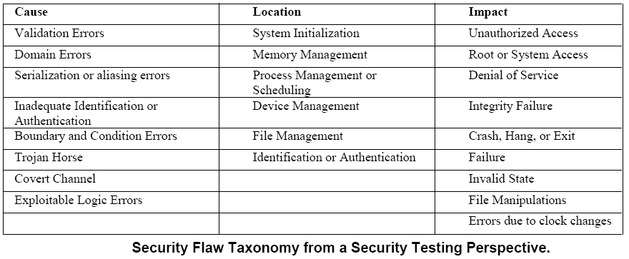
Security Flaws – Identified through Testing
Notes:
Software security is about making software behave in the presence of a malicious attack, even though in the real world, software failures usually happen spontaneously—that is, without intentional mischief

Slide 16
Questions
Thank You !

